Slide 1
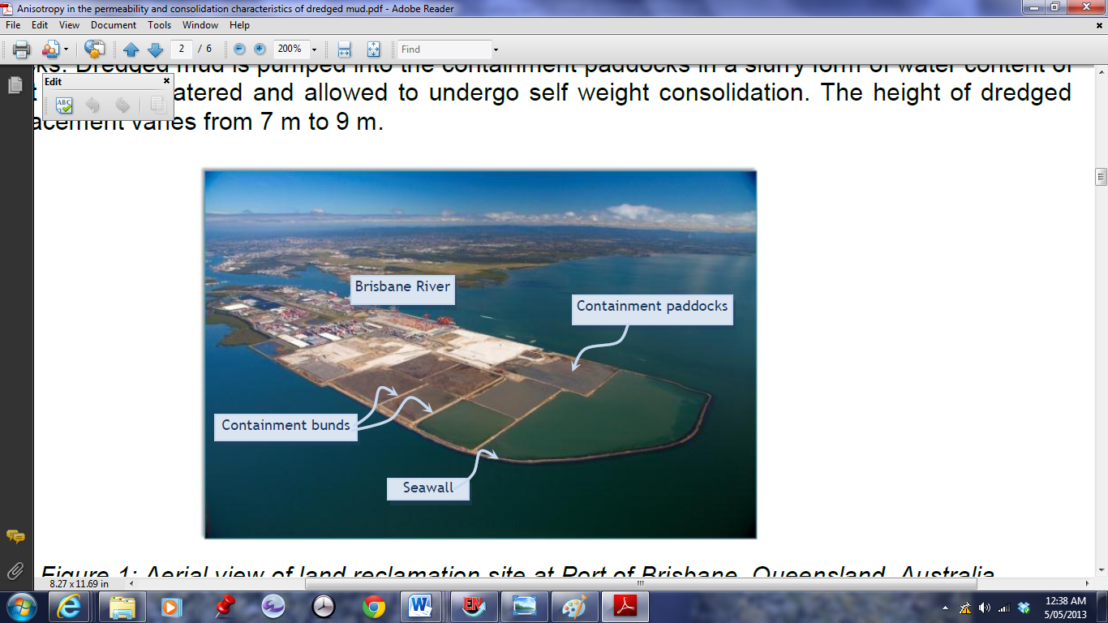
The Port of Brisbane
Land Reclamation - containment bunds filled with dredged materials (clays and silts)
Underlain by thick holocene clay layer up to 30m in depth
Difficulty to estimate the rate of settlement
Aerial view of land reclamation at the Port of Brisbane
(Ganesalingam et al. 2012a)

Slide 2
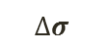
What is the rate of consolidation when three dimensions are considered?
$$∆σ$$
Three Dimensional
Axisymmetric Consolidation

Slide 3
Quantifying the Rate of Three Dimensional Consolidation
Samantha Thomas
Bachelor of Civil Engineering
Supervisor: Julie Lovisa

Slide 4
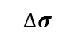
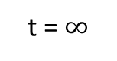
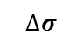
What is Consolidation?
Reduction in volume of a soil stratum due to an application of stress
$$∆σ$$
$$∆σ$$
GL
∆H
GL
H0
Clay (e0)
H
Clay
(e0 - ∆e)
t = 0
t = $∞$

Slide 5
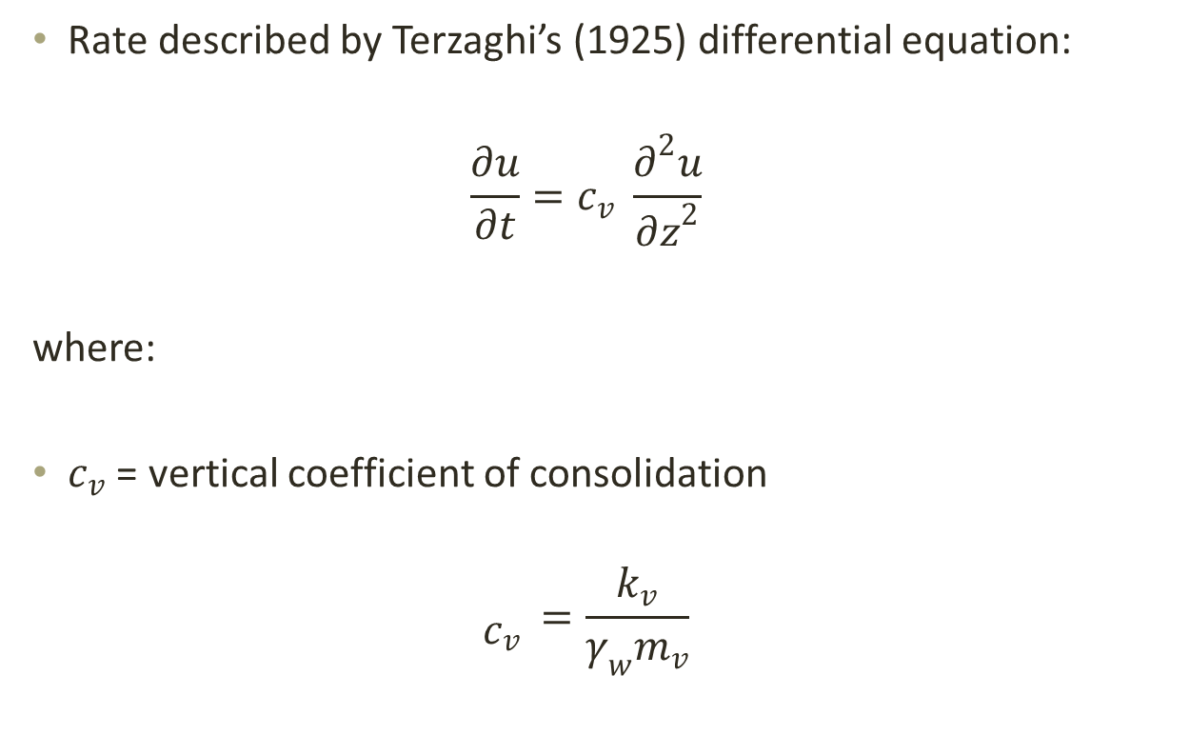
One Dimensional Consolidation
Rate described by Terzaghi’s (1925) differential equation:
$$\frac{∂u}{∂t}=c_{v} \frac{∂^{2}u}{{∂z}^{2}}$$
where:
$c_{v}$ = vertical coefficient of consolidation
$${\begin{aligned} \\ c\end{aligned}}_{v }=\frac{k_{v}}{γ_{w}m_{v}}$$

Slide 6
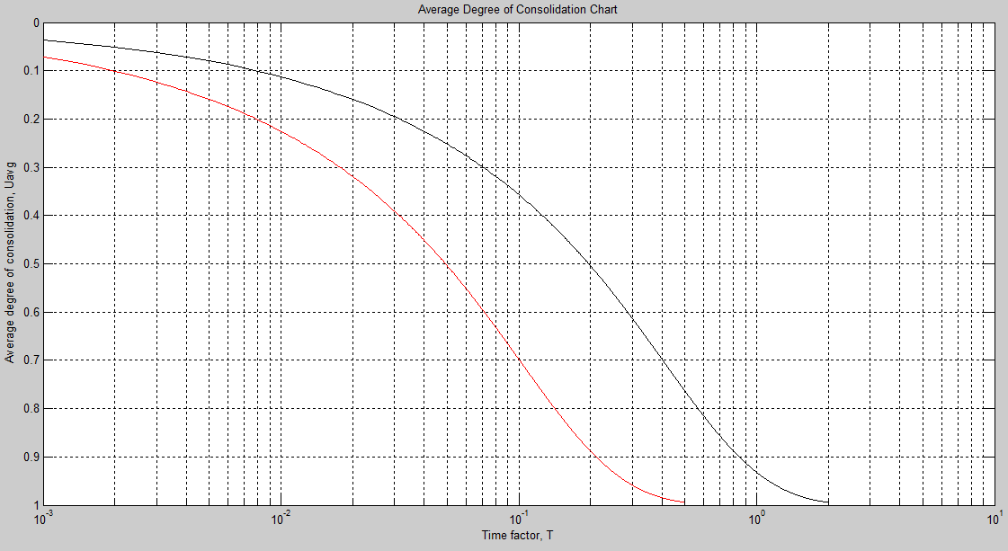
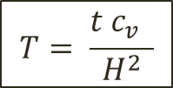
Average Degree of Consolidation (U-T) Curves
One Dimensional Curves for a Singly and Doubly Drained Soil Strata
Singly Drained
Doubly Drained
$$T= \frac{{t c_{v}}_{ } }{H^{2}}$$

Slide 7
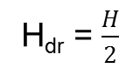
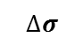
Doubly/Singly Drained Soil Strata
$$∆σ$$
$$∆σ$$
Permeable Boundary
Permeable Boundary
H
Clay
H_{dr} = $\frac{H}{2}$
H
Clay
H_{dr} = H
Permeable Boundary
Impermeable Boundary
Doubly Drained Soil Strata
Singly Drained Soil Strata

Slide 8
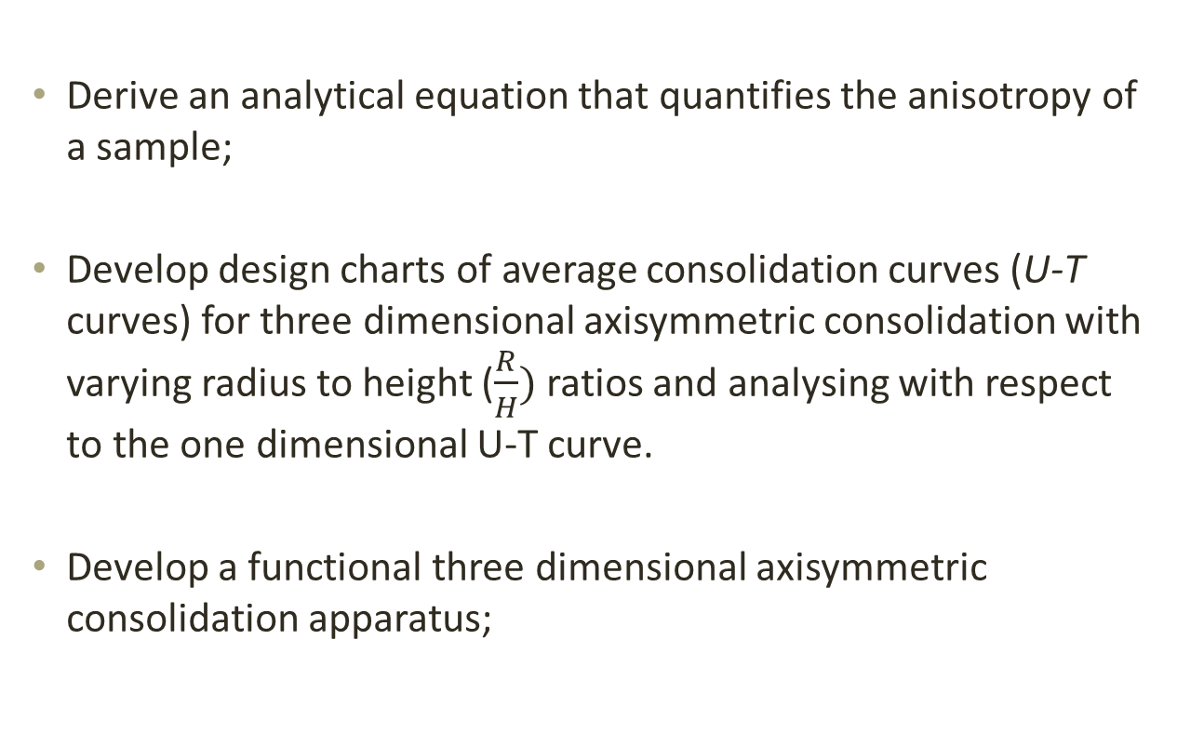
The objectives of this thesis were to:
Derive an analytical equation that quantifies the anisotropy of a sample;
Develop design charts of average consolidation curves (U-T curves) for three dimensional axisymmetric consolidation with varying radius to height ($\frac{R}{H})$ ratios and analysing with respect to the one dimensional U-T curve.
Develop a functional three dimensional axisymmetric consolidation apparatus;

Slide 9
Anisotropy
Refers to elastic properties that are dependent on the orientation of the sample
Horizontal permeability (kh) and vertical permeability (kv) observed
Anisotropy in the coefficient of consolidation (cv and ch)

Slide 10
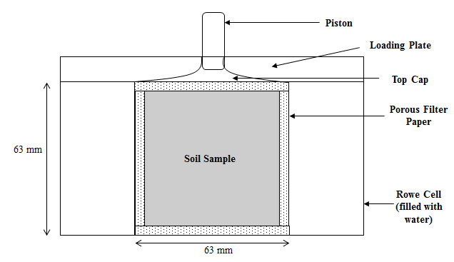
Objective: To develop a functional three dimensional axisymmetric consolidation apparatus
Schematic – Three Dimensional Axisymmetric Consolidation Apparatus

Slide 11
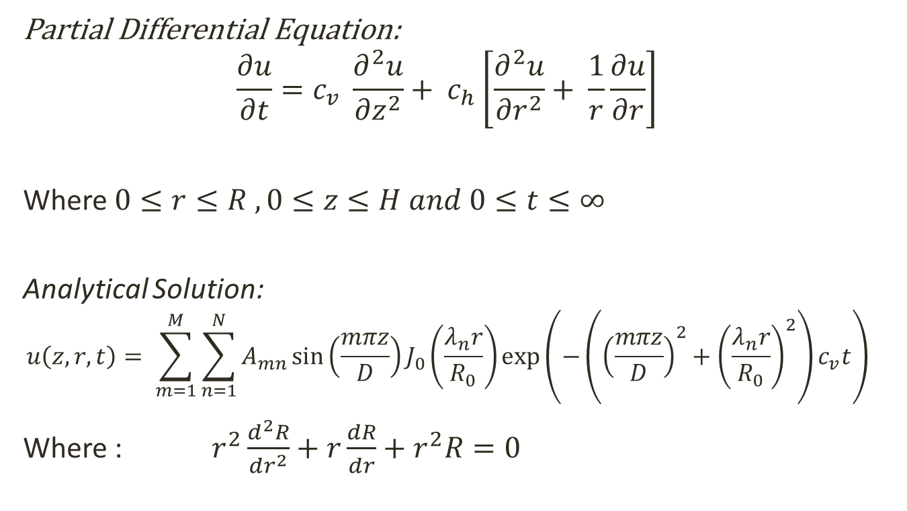
Objective: To derive an analytical equation that quantifies the anisotropy of a clay
Partial Differential Equation:
$$\frac{∂u}{∂t}=c_{v} \frac{∂^{2}u}{{∂z}^{2}}+ c_{h}\left[\frac{∂^{2}u}{{∂r}^{2}}+ \frac{1}{r}\frac{∂u}{∂r}\right]$$
Where $0≤r≤R , 0≤z≤H and 0≤t≤∞$
Analytical Solution:
$$u\left(z,r,t\right)= \sum_{m=1}^{M}{\sum_{n=1}^{N}{A_{mn}\sin\left(\frac{mπz}{D}\right)J_{0}\left(\frac{λ_{n}r}{R_{0}}\right)\exp\left(−\left({\left(\frac{mπz}{D}\right)}^{2}+{\left(\frac{λ_{n}r}{R_{0}}\right)}^{2}\right)c_{v}t\right)}}$$
Where : $r^{2}\frac{d^{2}R}{dr^{2}}+r\frac{dR}{dr}+r^{2}R=0$
(Lovisa et al. 2014)

Slide 12
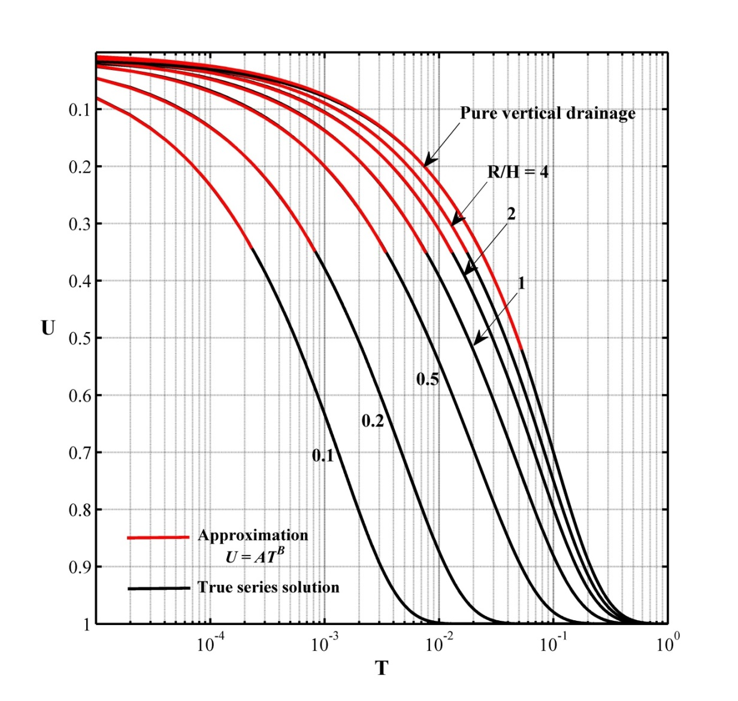
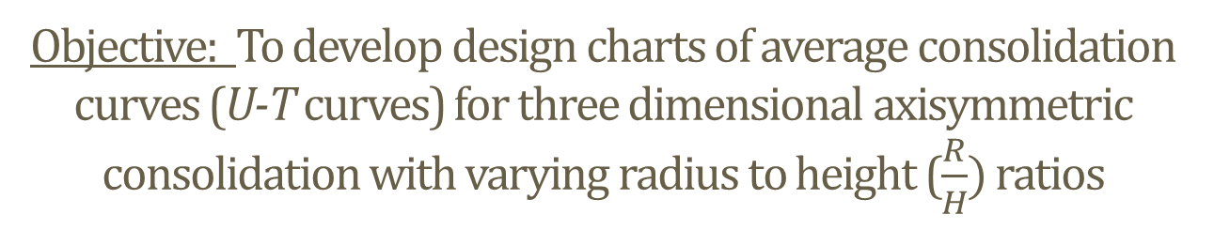
Objective: To develop design charts of average consolidation curves (U-T curves) for three dimensional axisymmetric consolidation with varying radius to height ($\frac{R}{H})$ ratios
Average Degree of Consolidation Curves for Varying R/H Ratios (Lovisa et al. 2014)

Slide 13
Modified Curve Fitting Parameters
 |  | Casagrande |  | Taylor
R/H x (C_{h}/C_{v})^{0.5} | Domain | f_{C} | T₅₀ | f_{T} | B | T₉₀
 | 52.1 | 4 | 0.049 | 1.15 | 0.5 | 0.212
320 | 52.1 | 4.15 | 0.048 | 1.14 | 0.49 | 0.212
7 | 32 | 4.23 | 0.0424 | 1.17 | 0.48 | 0.1968
4 | 32 | 4.27 | 0.037 | 1.21 | 0.48 | 0.185
3 | 29 | 4.29 | 0.034 | 1.24 | 0.47 | 0.176
2 | 27 | 4.33 | 0.029 | 1.29 | 0.47 | 0.158
1.5 | 27 | 4.38 | 0.0247 | 1.32 | 0.47 | 0.1418
1 | 27 | 4.4 | 0.017 | 1.38 | 0.47 | 0.11
0.8 | 27 | 4.4 | 0.0143 | 1.4 | 0.47 | 0.0915
0.6 | 27 | 4.4 | 0.0103 | 1.41 | 0.47 | 0.0666
0.5 | 27 | 4.38 | 0.008 | 1.43 | 0.47 | 0.052
0.4 | 27 | 4.43 | 0.0059 | 1.39 | 0.47 | 0.0376
0.3 | 27 | 4.42 | 0.0038 | 1.37 | 0.47 | 0.0235
0.2 | 27 | 4.41 | 0.0019 | 1.34 | 0.47 | 0.0115
0.1 | 27 | 4.4 | 0.00055 | 1.3 | 0.47 | 0.003
Modified curve-fitting parameters (Lovisa et al. 2014)

Slide 14
Modified Curve Fitting – Casagrande’s Method

Slide 15
Verification with Experimental Data

Slide 16
To Quantify Anisotropy
Average Degree of Consolidation Curves for Varying R/H Ratios (Lovisa et al. 2014)

Slide 17
Quantifying Anisotropy in Coefficient of Consolidation
Quantifying Anisotropy using Modified Time Factors – Casagrande’s Method (Lovisa et al. 2014)
Quantifying Anisotropy using Modified Time Factors – Taylor’s Method (Lovisa et. al 2014)

Slide 18
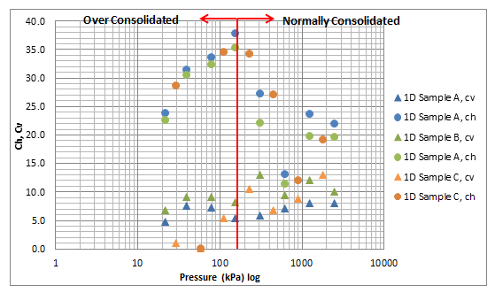
Quantifying the Horizontal Coefficient of Consolidation – Casagrande’s Method
Comparison between the Horizontal Coefficient of Consolidation and Vertical Coefficient of Consolidation – Casagrande’s Method

Slide 19
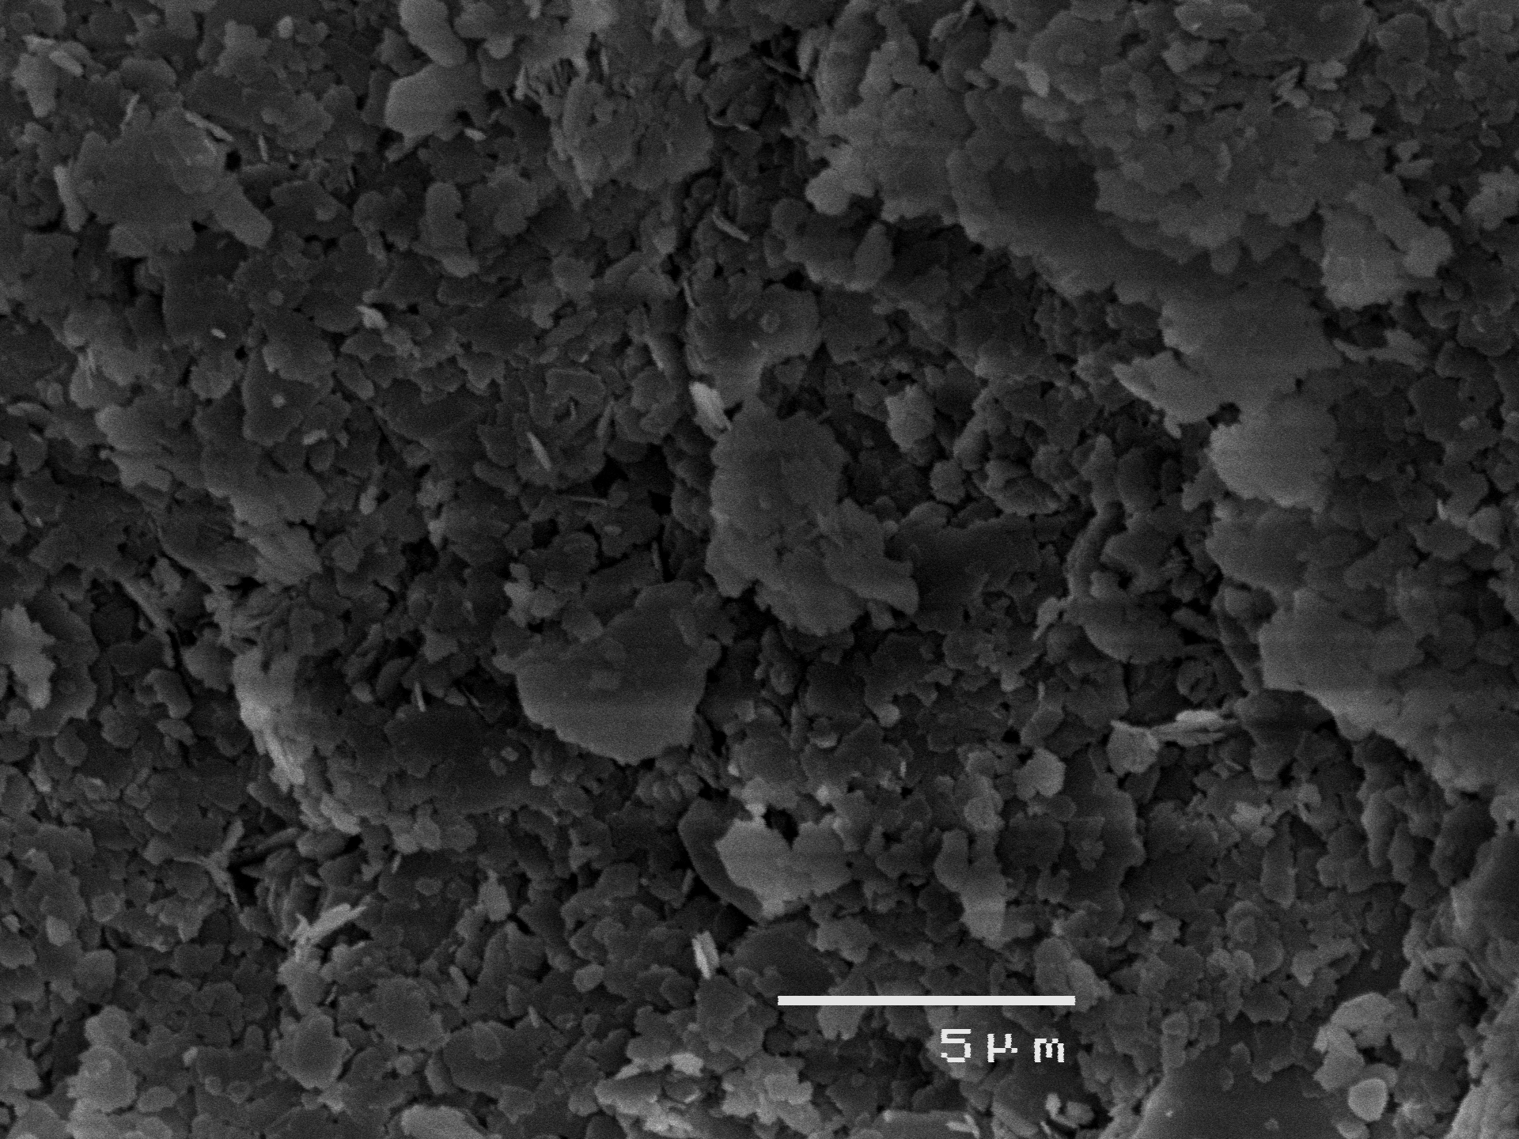
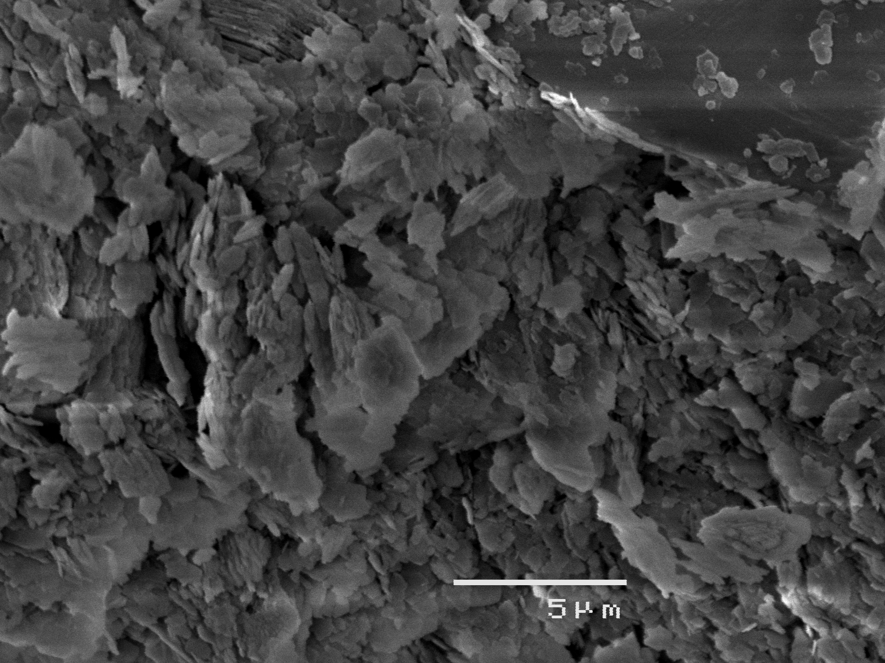
Scanning Electron Microscope
SEM Image – After Sample Preparation (Top View)
SEM Image - After Standard Oedometer

Slide 20
Conclusions
Consideration of Three Dimensional Consolidation
Decreased Curve fitting domain from 60% for 1D to 30% for 3D
 | Advantages | Disadvantages
Casagrande’s Method | - No change to actual curve, just fitting procedure | -Use of modified curve fitting method has a large effect on the horizontal coefficient of consolidation obtained
Taylor’s Method | -Minimal difference in the coefficient of consolidation obtained using the modified method | Many coefficient of consolidation values could not be quantified for early load increments

Slide 21
Significance to the Geotechnical Community
TIME REDUCTION
COST REDUCTION
Ability to complete experimental procedure in a shorter period of time through the use of a 3D apparatus
Allows the coefficient of consolidation to be determined quicker, and settlement calculation completed
Allows a more accurate estimate of the time of consolidation in field application due to the consideration of horizontal drainage
A shorter time estimate allows works to be completed on the consolidating layer sooner, resulting in cost reduction.

Slide 22
Any Questions?

Slide 23
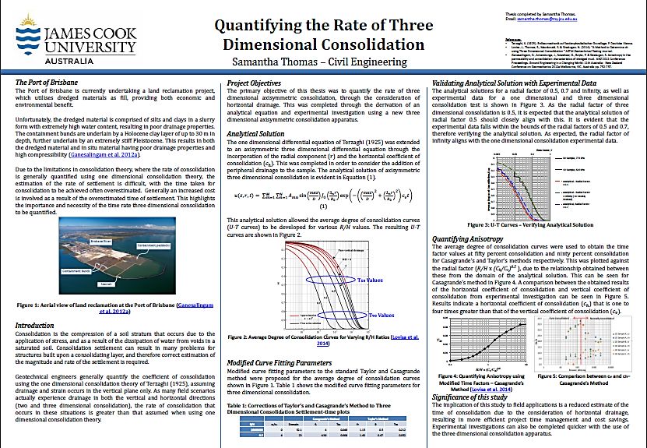
Poster

Slide 24
References
Ganesalingam, D., Ameratunga, J., Scweitzer, G., Boyle, P. & Sivakugan, S. Anisotropy in the permeability and consolidation characteristics of dredged mud. ANZ 2012 Conference Proceedings. Ground Engineering in a Changing World: 11th Australia - New Zealand Conference on Geomechanics 2012a Melbourne, VIC, Australia pp. 752-757.
Lovisa, J., Thomas, S., Macdonald, S. & Sivakugan, N. (2014). "A Method to Determine ch using Three Dimensional Consolidation " ASTM Geotechnical Testing Journal.
Lovisa, J. & Sivakugan, N. "Tall Oedometer Testing: A Method to account for wall friction."

Slide 25
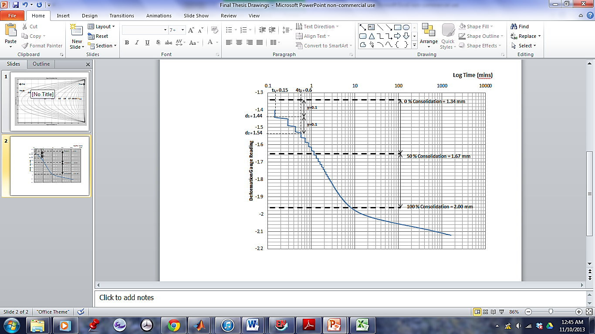
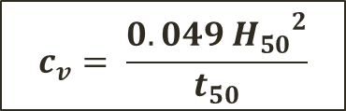
Curve Fitting – Casagrande’s Method
Fits a point at 50% consolidation
$$c_{v}= \frac{0.049 {H_{50}}^{2}}{t_{50}}$$
Casagrande’s Log Time Method (using experimental results if 155 kPa loading increment)

Slide 26
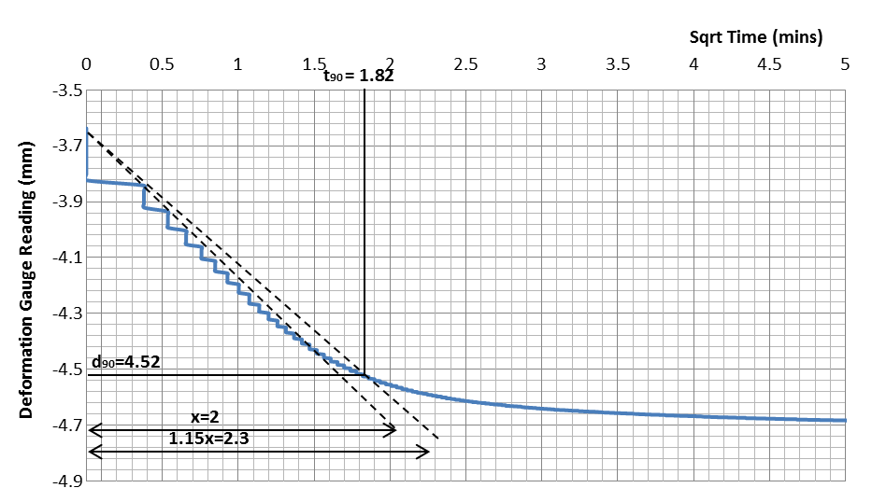
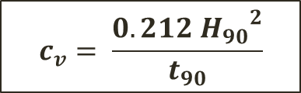
Curve Fitting – Taylor’s Method
Fits a point at 90% consolidation
$$c_{v}= \frac{0.212 {H_{90}}^{2}}{t_{90}}$$
Taylor’s Square Root of Time Method, (using experimental results of 618 kPa increment)

Slide 27
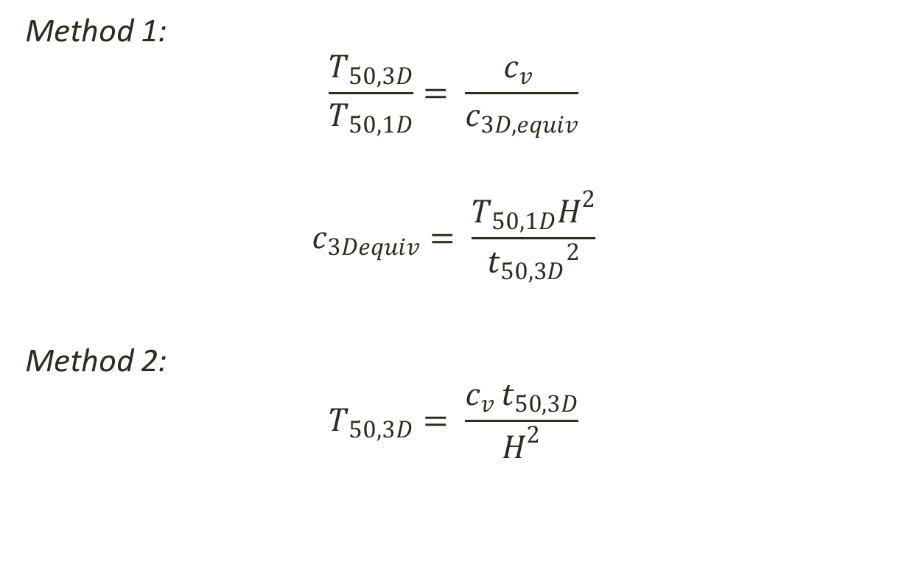
Determining T50, 3D
Method 1:
$$\frac{T_{50,3D}}{T_{50,1D}}= \frac{c_{v }}{c_{3D,equiv}}$$
$$c_{3Dequiv}= \frac{T_{50,1D}H^{2}}{{t_{50,3D}}^{2}}$$
Method 2:
$$T_{50,3D}= \frac{c_{v }t_{50,3D}}{H^{2}}$$

Slide 28
Falling Head Permeability Testing
Comparison Between the Coefficient of Consolidation obtained from Taylor’s and Casagrande’s method, and the direct determination of permeability.

Slide 29
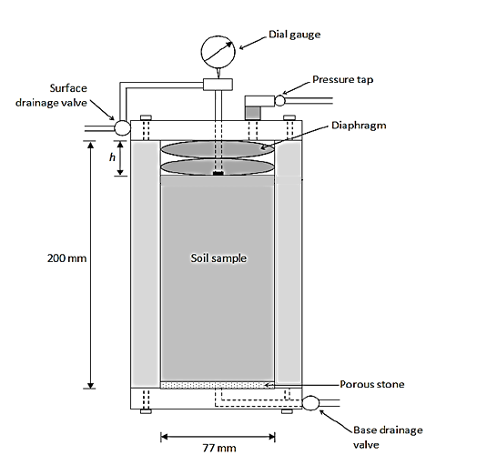
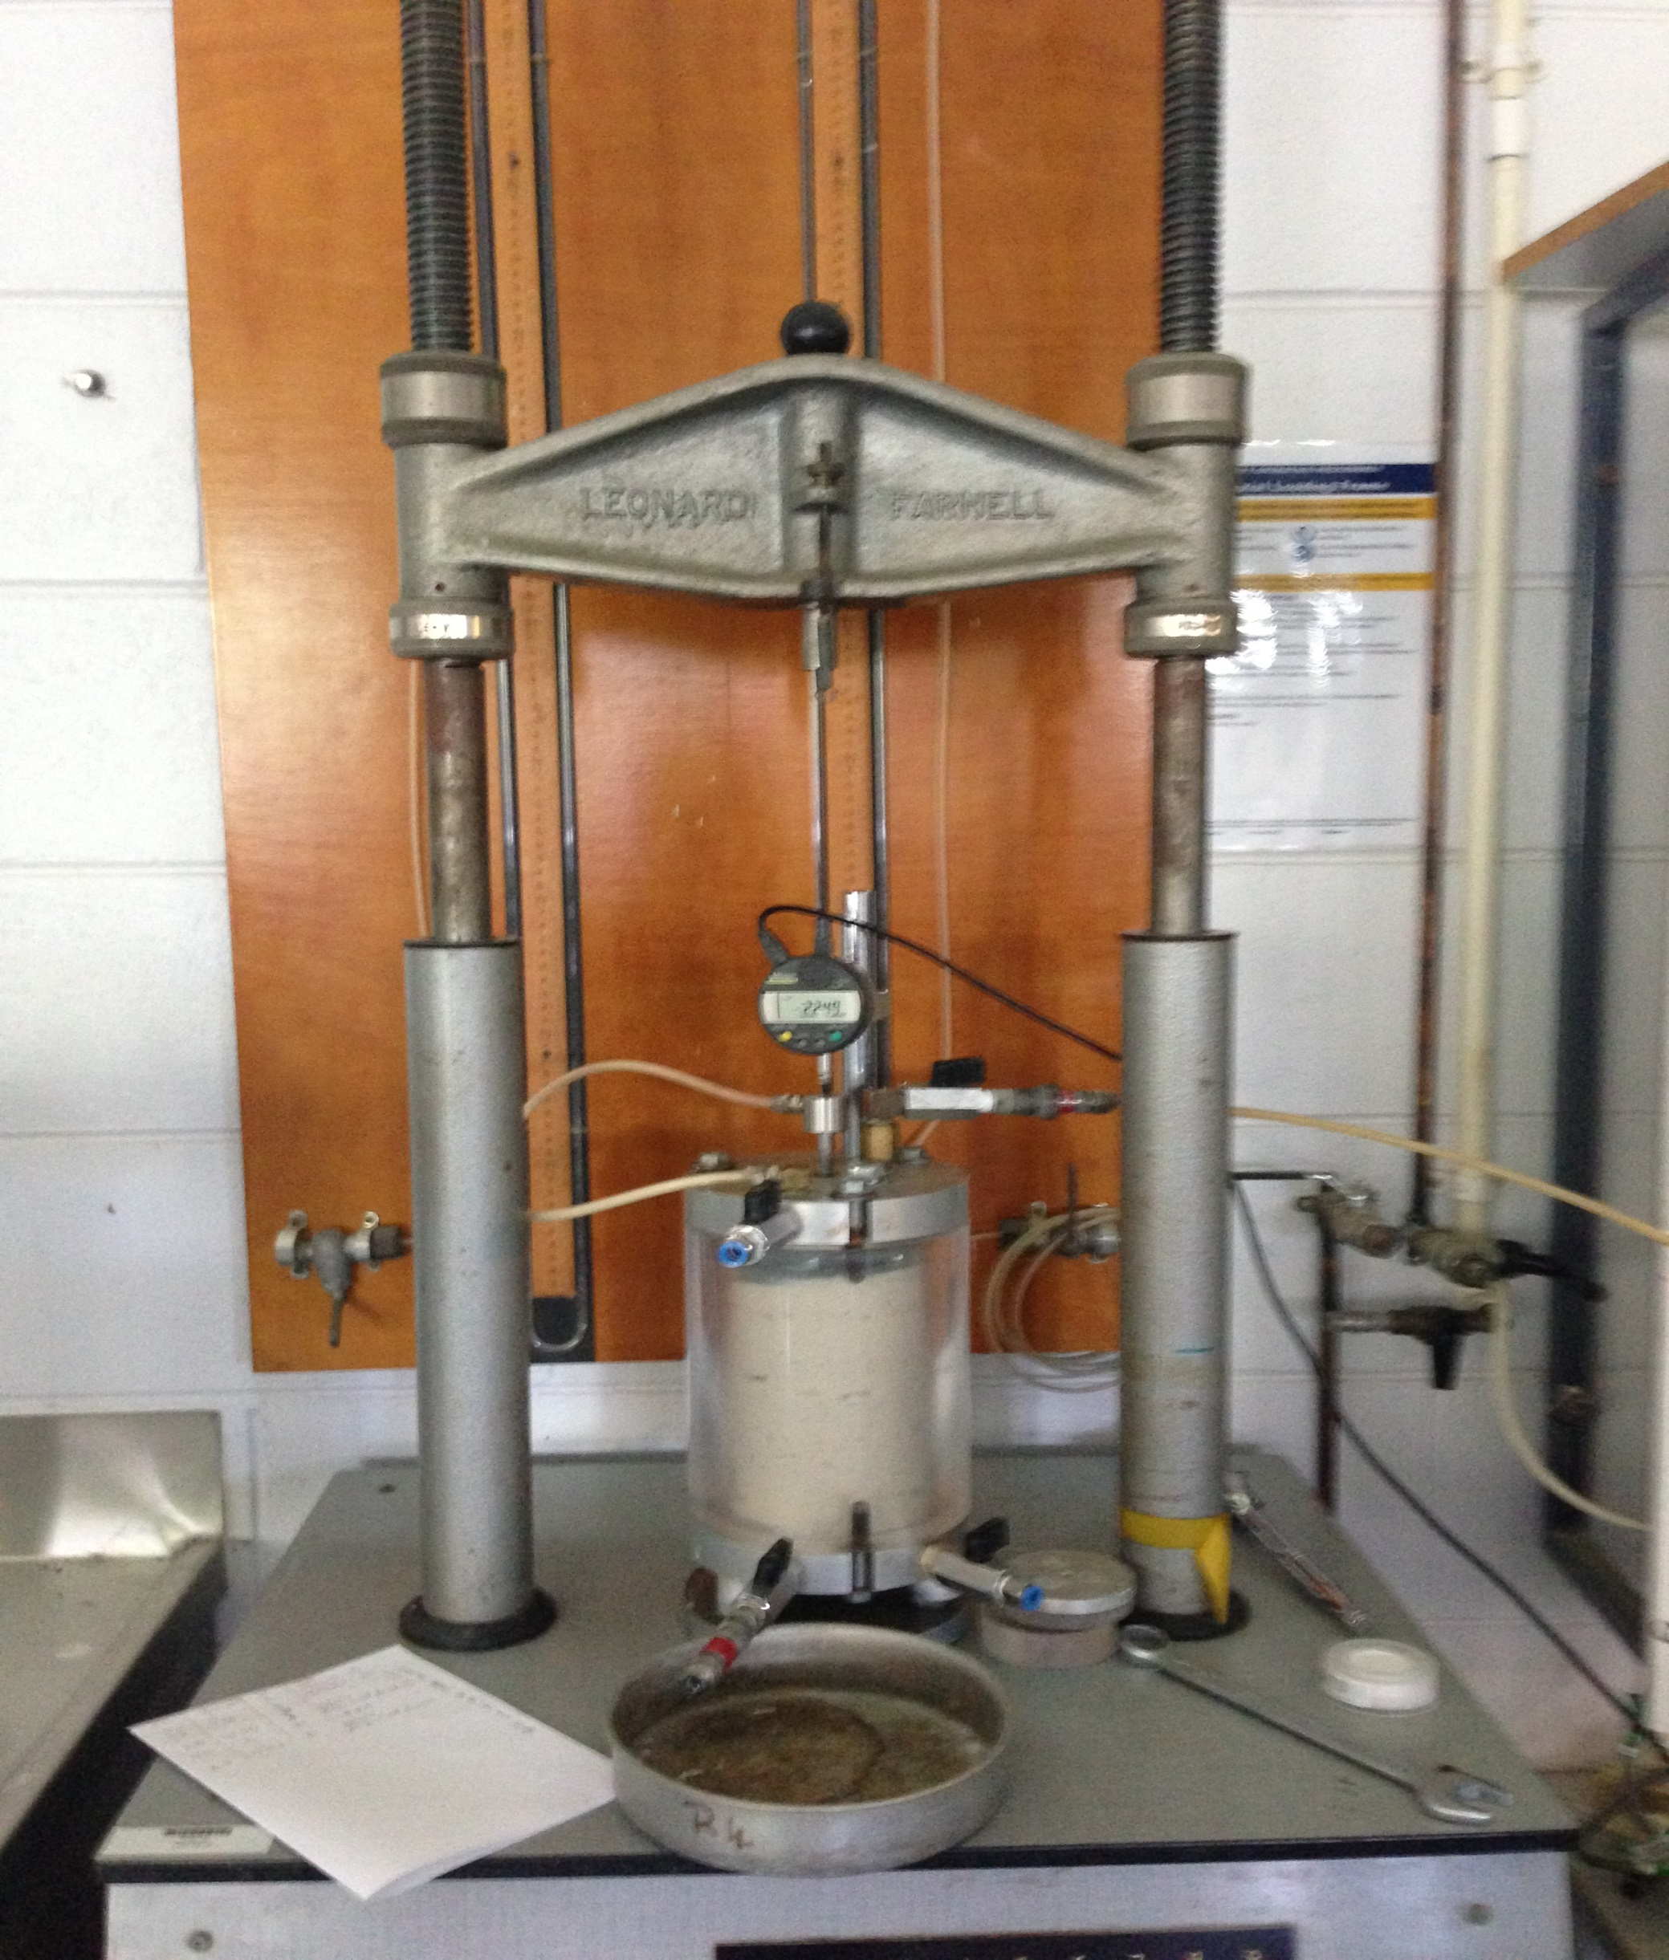
Sample Preparation – Tall Oedometer
Dial Gauge
Pressure Tap
Surface Drainage Valve
Soil Sample
Base Drainage Valve
Tall Oedometer Schematic
Tall Oedometer Apparatus

Slide 30
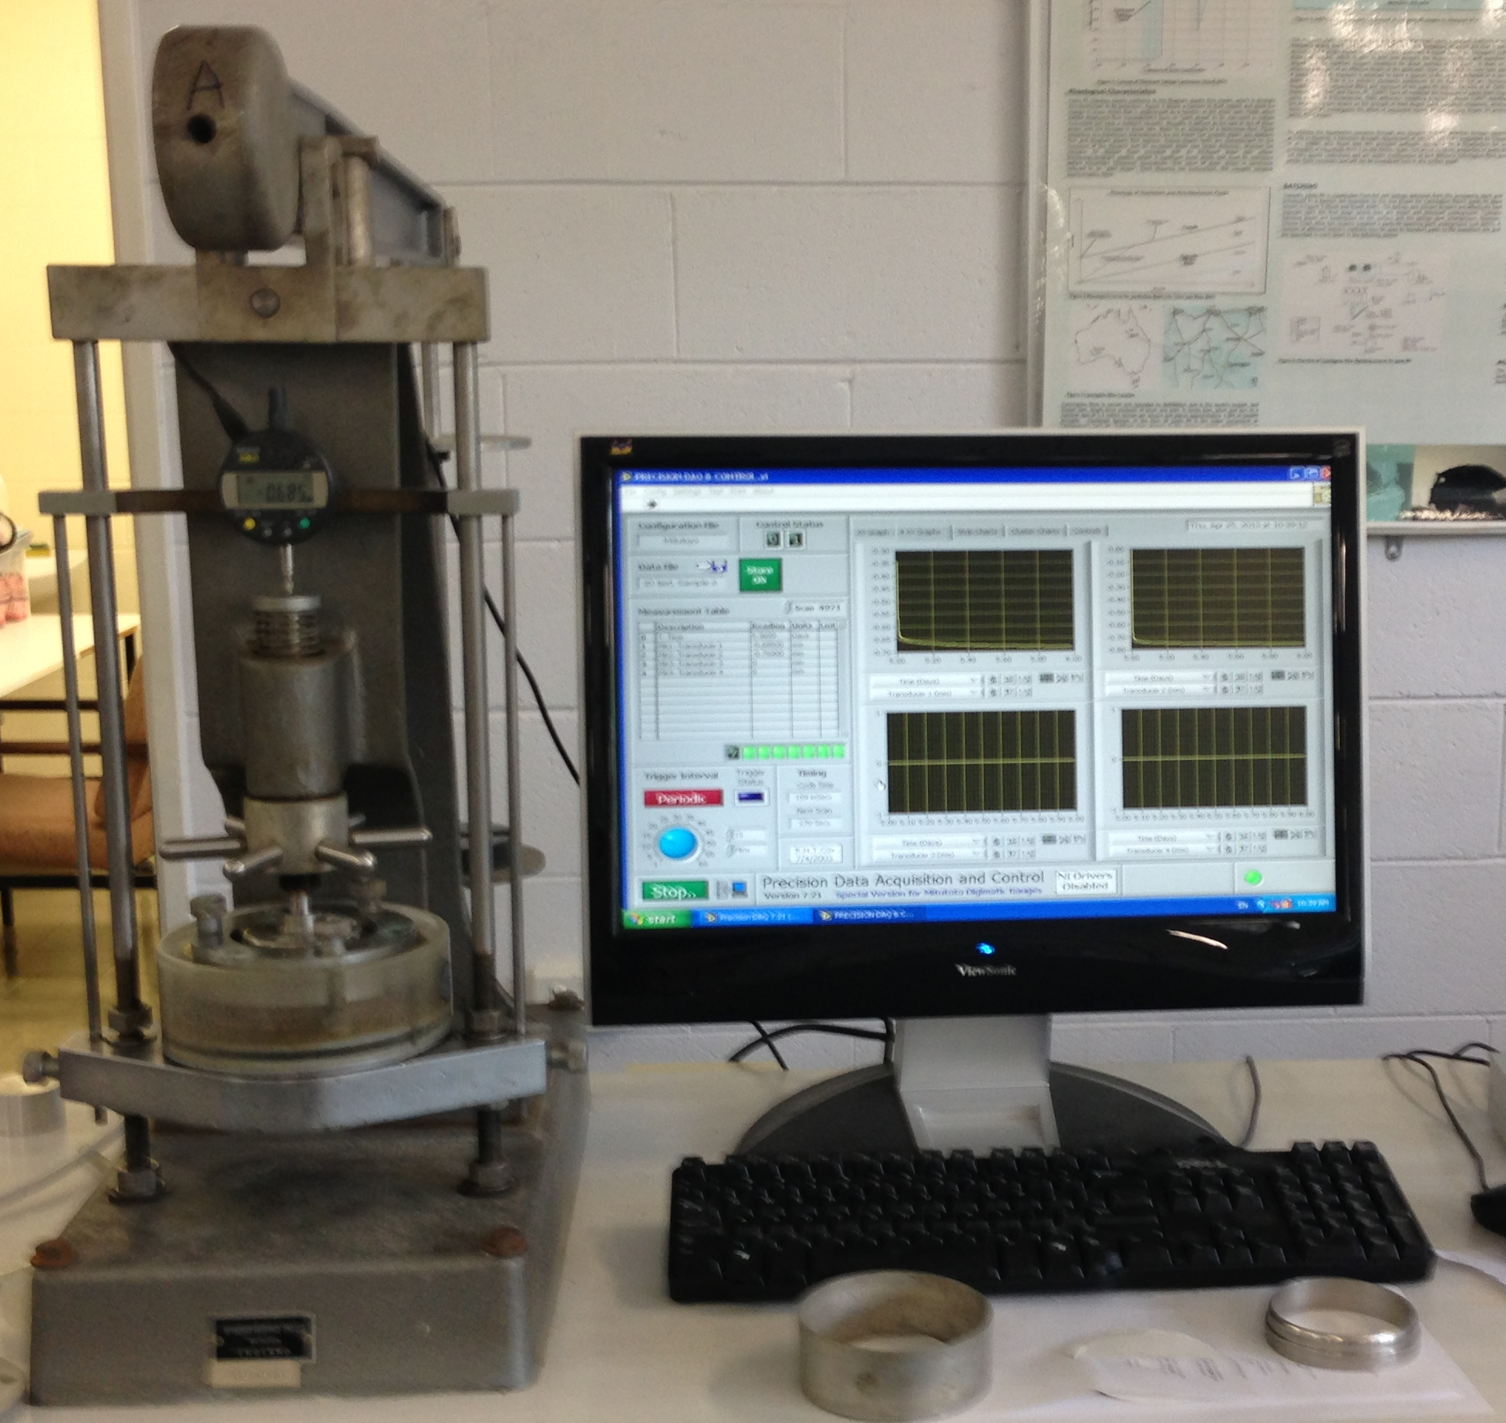
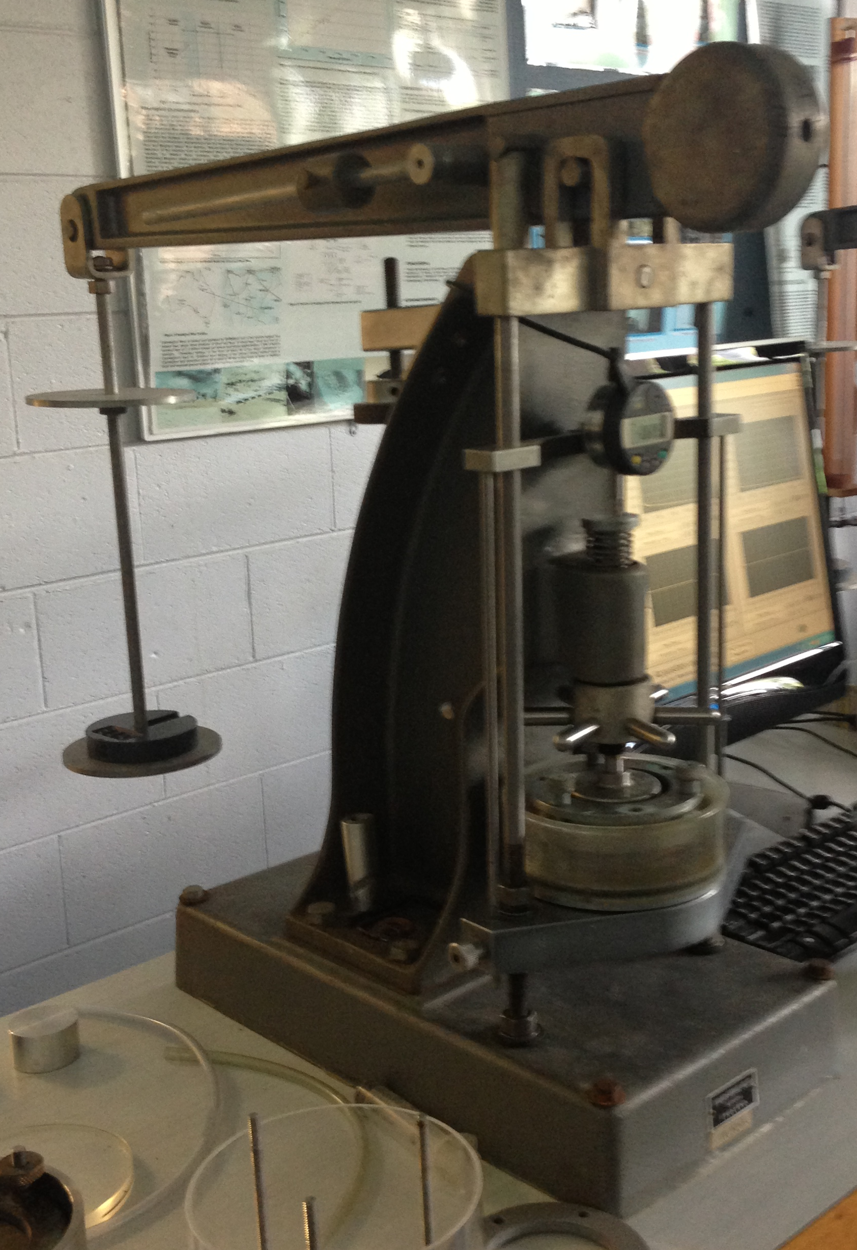
Standard Oedometer
Rowe Cell
Time-settlement
monitoring
Lever Arm

Slide 31
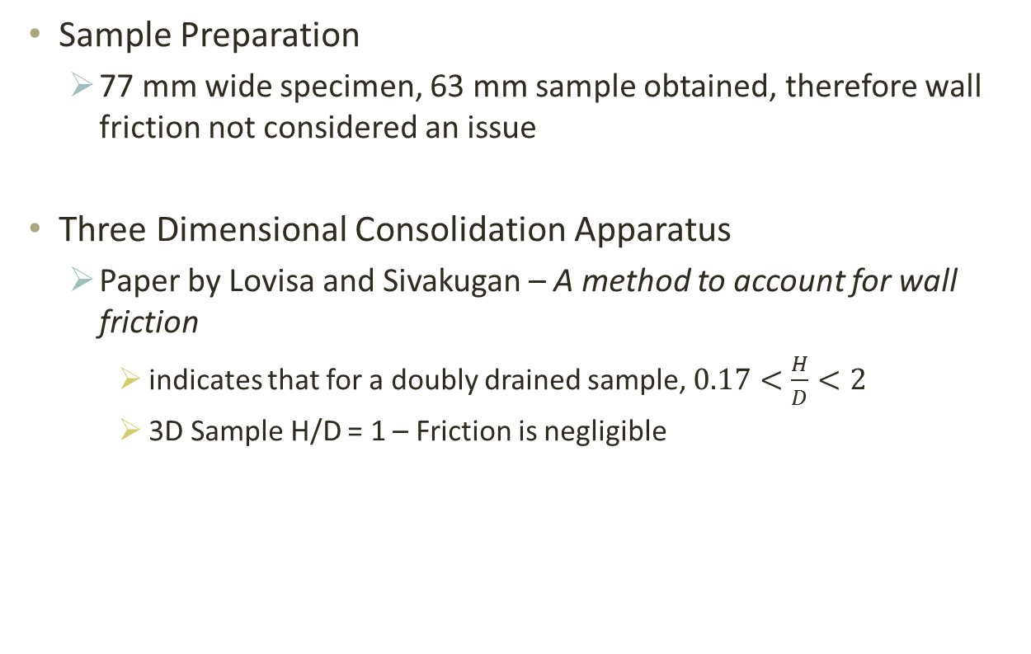
Is Wall Friction a Factor?
Sample Preparation
77 mm wide specimen, 63 mm sample obtained, therefore wall friction not considered an issue
Three Dimensional Consolidation Apparatus
Paper by Lovisa and Sivakugan – A method to account for wall friction
indicates that for a doubly drained sample, $0.17<\frac{H}{D}<2$
3D Sample H/D = 1 – Friction is negligible

Slide 32
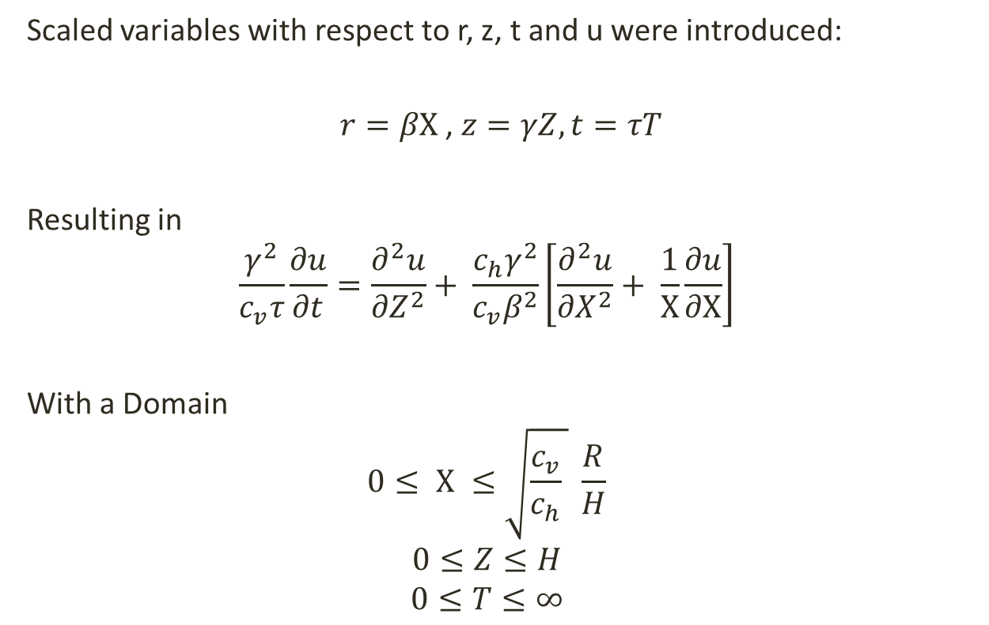
Solving PDE – Three Dimensional Consolidation
Scaled variables with respect to r, z, t and u were introduced:
$r=βΧ$ , $z=γZ, t=τT$
Resulting in
$$\frac{γ^{2}}{c_{v}τ}\frac{∂u}{∂t}=\frac{∂^{2}u}{{∂Z}^{2}}+ \frac{c_{h}γ^{2}}{c_{v}β^{2}}\left[\frac{∂^{2}u}{{∂X}^{2}}+ \frac{1}{Χ}\frac{∂u}{∂Χ}\right]$$
With a Domain
$$0≤ Χ ≤\sqrt{\frac{c_{v}}{c_{h}} } \frac{R}{H}$$
$$0≤Z≤H$$
$$0≤T≤∞$$

Slide 33
Current Approaches
Analytical:
Terzaghi and Rendulic (1937)
Biot (1945)
Numerical

Slide 34
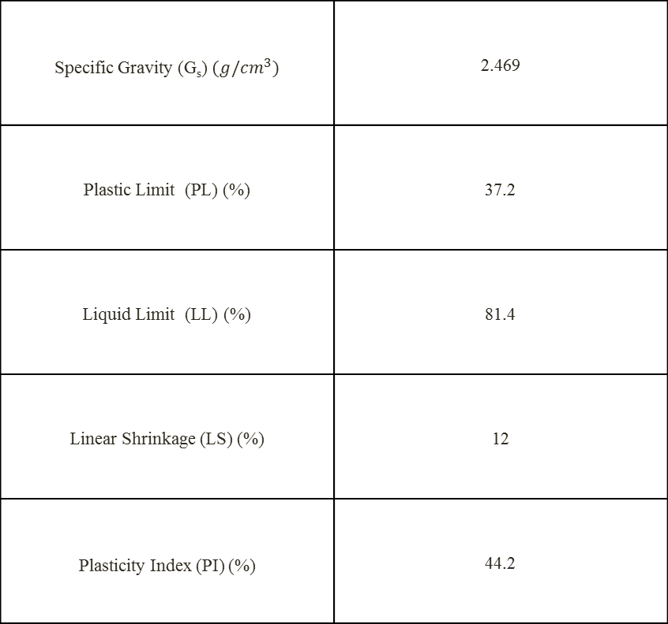
Properties of Experimental Clay - Kaolinite
Specific Gravity (G_{s}) $(g/cm^{3})$ | 2.469
Plastic Limit (PL) (%) | 37.2
Liquid Limit (LL) (%) | 81.4
Linear Shrinkage (LS) (%) | 12
Plasticity Index (PI) (%) | 44.2

Slide 35
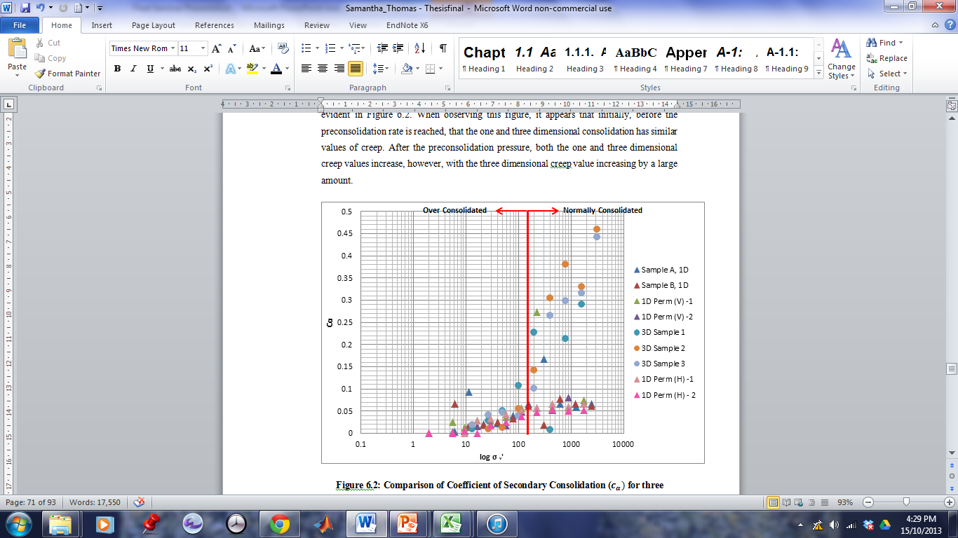
Further Experimental Observations - Creep
Comparison of Coefficient of Secondary Consolidation ($c_{α})$ for three dimensional and one dimensional consolidation

Slide 36
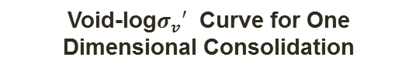
Compression/Recompression Index
Compression Index and Recompression Index Values for Experimental Results
 | Compression Index (Cc) | Recompression Index (Cr)
1D, Vertically Cut Samples | 1.251 | 0.450
 | 1.562 | 0.296
 | 1.508 | 0.386
 | 1.223 | 0.321
1D, Horizontally Cut Samples | 0.587 | 0.319
 | 0.629 | 0.249
3D Samples | 1.046 | 0.147
 | 1.329 | 0.287
 | 1.262 | 0.419
Void-log$σ_{v}′$ Curve for One Dimensional Consolidation

